Slide 1





1

Slide 2

Introduction
Basics of Scala Programming Language
Object-Oriented Programming with Scala
Functional Programming with Scala
The Road Ahead
Q&A
2

Slide 3

3

Slide 4
Scala is an acronym for
Scalable Language
Is so named because it was designed to grow with the demands of its users.
4

Slide 5

The work on Scala was motivated by two hypotheses: Hypothesis 1: A general-purpose language needs to be
scalable; the same concepts should describe small as well as large parts.
Hypothesis 2: Scalability can be achieved by unifying and generalizing functional and object-oriented programming concepts.
5

Slide 6

Agile, with lightweight syntax No boilerplate code
Object-Oriented
Functional
Safe and Performant, with strong static typing
If we were forced to name just one aspect of Scala that helps scalability, we’d pick it combination of object-oriented and functional programming.
6

Slide 7

Scala compiles to Byte Code in the JVM. Scala programs compile to JVM bytecodes. Their run-time performance is usually on par with Java programs.
You can write a .class being java or scala code.
Interoperability with Java, So you can easily use the Java Ecosystem.
7

Slide 8

Scala is concise. No boilerplate code! (semicolons, return, getter/setter, …)
Fewer lines of code mean not only less typing, but also less effort at reading and understanding programs and fewer possibilities of defects.
Scala is high-level. OOP and FP let you write more complex programs.
Scala is statically typed, verbosity is avoided through type inference so it look likes it’s a dynamic language but it’s not.
8

Slide 9
If I were to pick a language to use today other than Java, it would be Scala.
James Gosling, the creator of the Java programming language
9

Slide 10




10

Slide 11

Big Data and Data Science
Web Application Development, REST API Development
Distributed System, Concurrency and Parallelism
Scientific Computation like NLP, Numerical Computing and Data Visualization
11

Slide 12

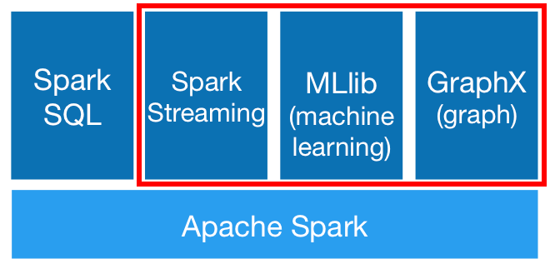
Apache Spark is written in Scala. You can use Spark for machine learning, graph processing, streaming and generally as an in- memory distributed, fault-tolerant data processing engine.
12

Slide 13
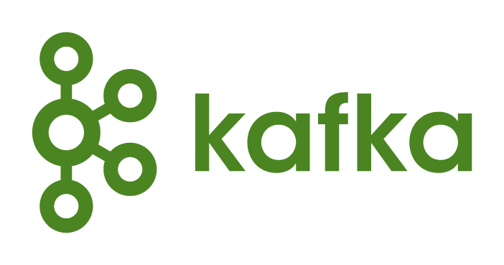
Apache Kafka is written in Scala and Java. It provides a unified, high-throughput, low-latency platform for handling real-time data feeds.

Slide 14

Apache Samza is a distributed stream processing framework written in Java and Scala. It uses Apache Kafka for messaging, and Apache Hadoop YARN to provide fault tolerance, processor isolation, security, and resource management.

Slide 15
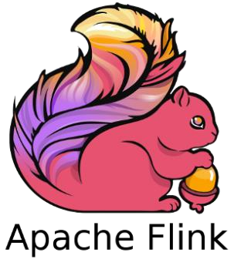
Apache Flink is a distributed streaming dataflow engine written in Java and Scala.

Slide 16

Play is a stateless, asynchronous, and non-blocking framework that uses an underlying fork-join thread pool to do work stealing for network operations, and can leverage Akka for user level operations.
Play Framework makes it easy to build web applications with Java & Scala.

Slide 17

Lift claim that it is the most powerful, most secure web framework available today.
It’s Secure, Scalable, Modular, Designer friendly, and Developer centric.

Slide 18

Spray is an open-source toolkit for building REST/HTTP-based integration layers on top of Scala and Akka.
Being asynchronous, actor-based, fast, lightweight, modular and testable it's a great way to connect your Scala applications to the world.

Slide 19

Scalatra is a simple, accessible and free web micro-framework.
It combines the power of the JVM with the beauty and brevity of Scala, helping you quickly build high-performance web sites and APIs.

Slide 20


Akka is open source middleware for building highly concurrent, distributed and fault-tolerant systems on the JVM.
Akka is built with Scala, but offers both Scala and Java APIs to developers.
At the heart of Akka is the concept of Actors, which provide an ideal model for thinking about highly concurrent and scalable systems.

Slide 21


Scala NLP library including Breeze, Epic, Puck.
Wisp is a web-based plotting library.
ADAM is a genomics processing engine and specialized file format built using Apache Avro, Apache Spark and Parquet.
Scala-Chart is another library for creating and working with carts.
Scalalab is an easy and efficient MATLAB-like scientific computing library in Scala

Slide 22












https://www.lightbend.com/resources/case-studies-and-storie
22

Slide 23
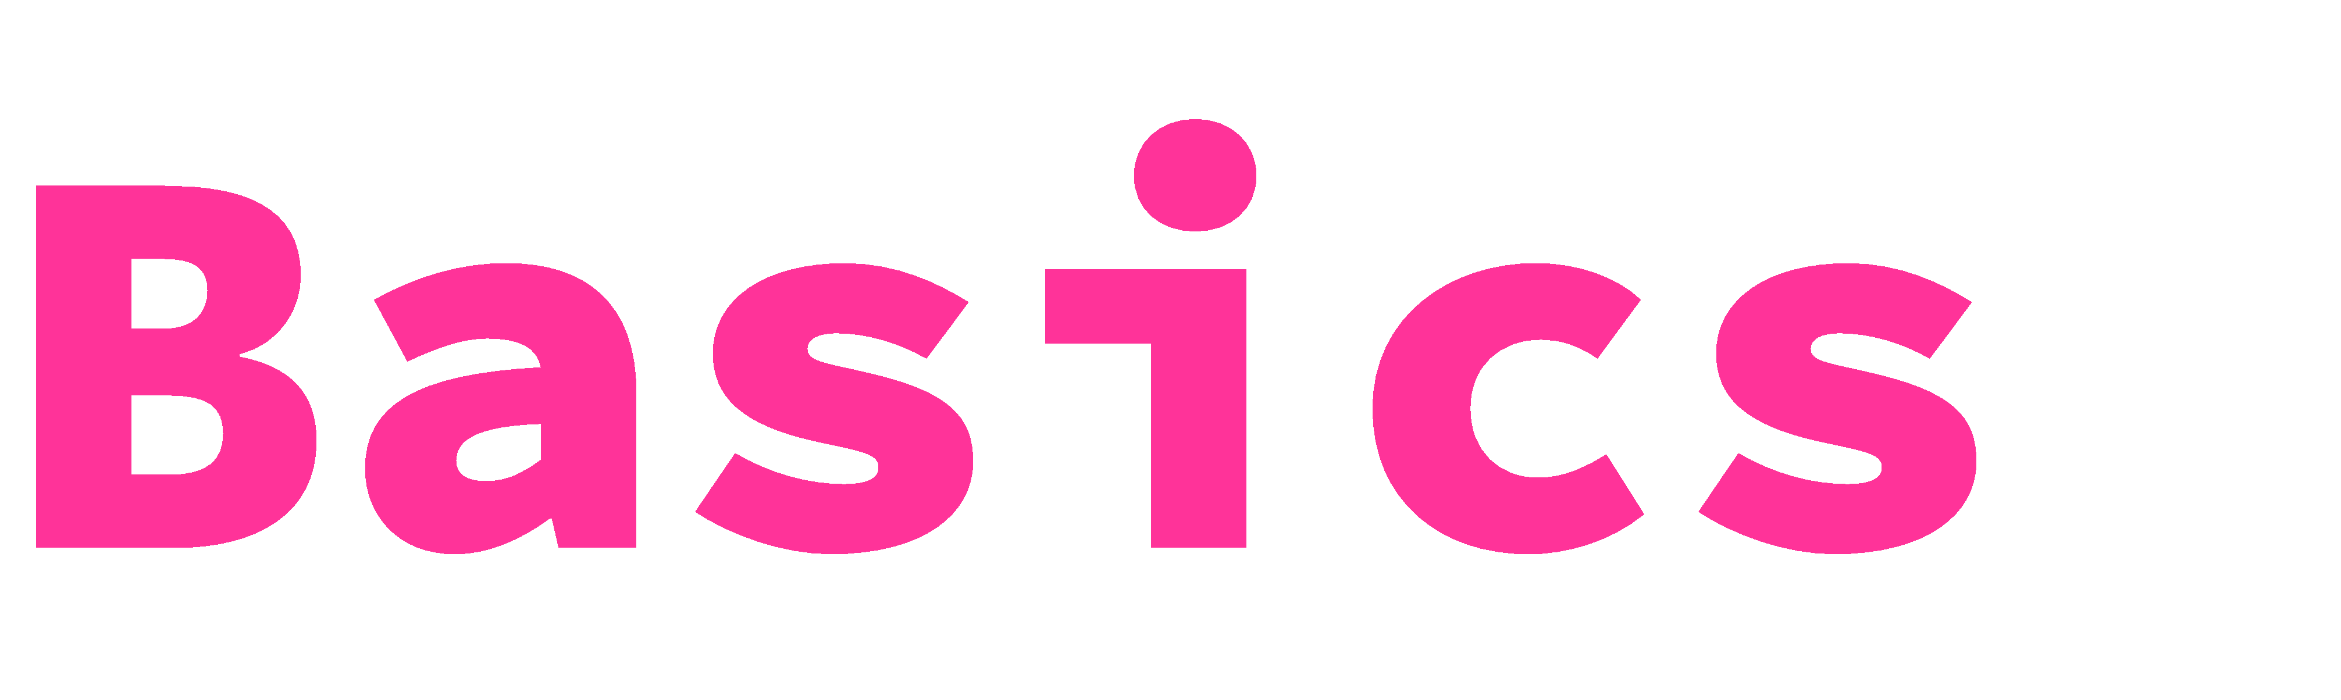

Slide 24

Scala, unlike some of the other statically typed languages (C, Pascal, Rust, etc.), does not expect you to provide redundant type information. You don't have to specify a type in most cases, and you certainly don't have to repeat it.
Scala has a unified type system, enclosed by the type Any at the top of the hierarchy and the type Nothing at the bottom of the hierarchy
val name = "KNTU“
name: String = KNTU
val id = 12L
id: Long = 12
val pi:Float = 3.14F
pi: Float = 3.14

Slide 25
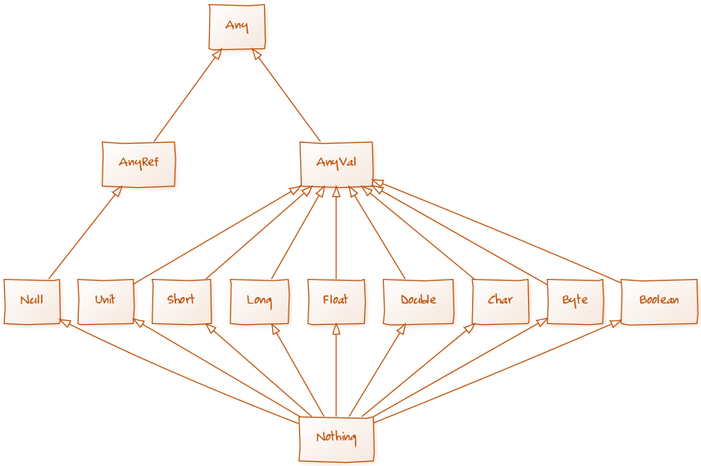

Slide 26
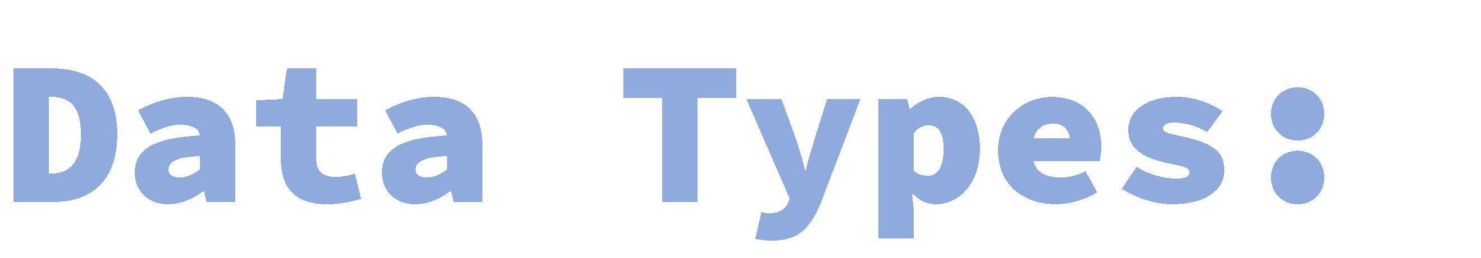
var a:Int=2
a: Int = 2
var a:Double=2.2
a: Double = 2.2
var a:Float=2.2F
a: Float = 2.2
var a:Byte=4
a: Byte = 4
var a:Boolean=false
a: Boolean = false println(a)
false res0: Unit = ()
Byte
Short
Int
Long
Float
Double
Char
Boolean
Unit

Slide 27
// variable
var name = "foo" name = "bar"
// value val age = 18 age = 20

Slide 28



An expression-oriented programming language is a programming language where every (or nearly every) construction is an expression and thus yields a value.
All functional programming languages are expression-oriented.
As we seen, even “println” has return value of type Unit.

Slide 29


val name = "Rimaz"
name: String = Rimaz if(name.length() == 1 * 4){ "*"
} else{
"#"
}
res0: String = #
val name = "KNTU"
name: String = KNTU
if(name.length == 1.*(4)) "*" else "#"
res0: String = *

Slide 30


var count = 0
while(count < 10) count+=1
var count = 0
do count+=2 while(count<10)
Note: Avoid imperative style of programming like while loops and mutation, Think Functional.

Slide 31


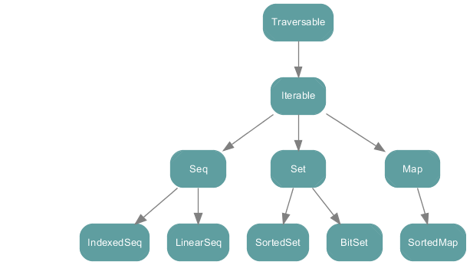

Slide 32

val range = 1 to 10
range: scala.collection.immutable.Range.Inclusive = Range 1 to 10
println(range.last) // 10
val range2 = 1 until 10
range2: scala.collection.immutable.Range = Range 1 until 10
println(range2.last) // 9
val range3 = 1 until 10 by 3
range3: scala.collection.immutable.Range = Range 1 until 10 by 3
println(range3.last) // 7

Slide 33

var tuples=(2*5,"ten",10.0d,10.0f,10.0,(9,"NINE"))
tuples: (Int, String, Double, Float, Double, (Int, String))
= (10,ten,10.0,10.0,10.0,(9,NINE))
print(tuples._1)
10
print(tuples._2)
ten
print(tuples._6._2)
NINE

Slide 34

var lst=List("b","c","d")
lst: List[String] = List(b, c, d)
print(lst.head)
b
print(lst.tail)
List(c, d)
var lst2="a"::lst
lst2: List[String] = List(a, b, c, d)
var l=1::2::3::4::Nil
l: List[Int] = List(1, 2, 3, 4)
var l2=l::List(5,6)
l2: List[Any] = List(List(1, 2, 3, 4), 5, 6)
var l3=l:::List(5,6)
l3: List[Int] = List(1, 2, 3, 4, 5, 6)

Slide 35

var array=new Array[String](3)
array: Array[String] = Array(null, null, null)
var at=Array(4,4.7,"Gasai Yuno")
at: Array[Any] = Array(4, 4.7, Gasai Yuno)
val mat = Array.ofDim[Int](3,4) mat(1)(2) = 3

Slide 36

val books = List("Beginning Scala", "Beginning Groovy", "Beginning Java", "Scala in 24 hours")
for (book<-books) println(book) var scalabooks =
for{ book <-books if book.contains("Scala") } yield book
scalabooks: List[String] = List(Beginning Scala, Scala in 24 hours) for(book<-books if book.contains("Scala") ) println(book)

Slide 37





Slide 38
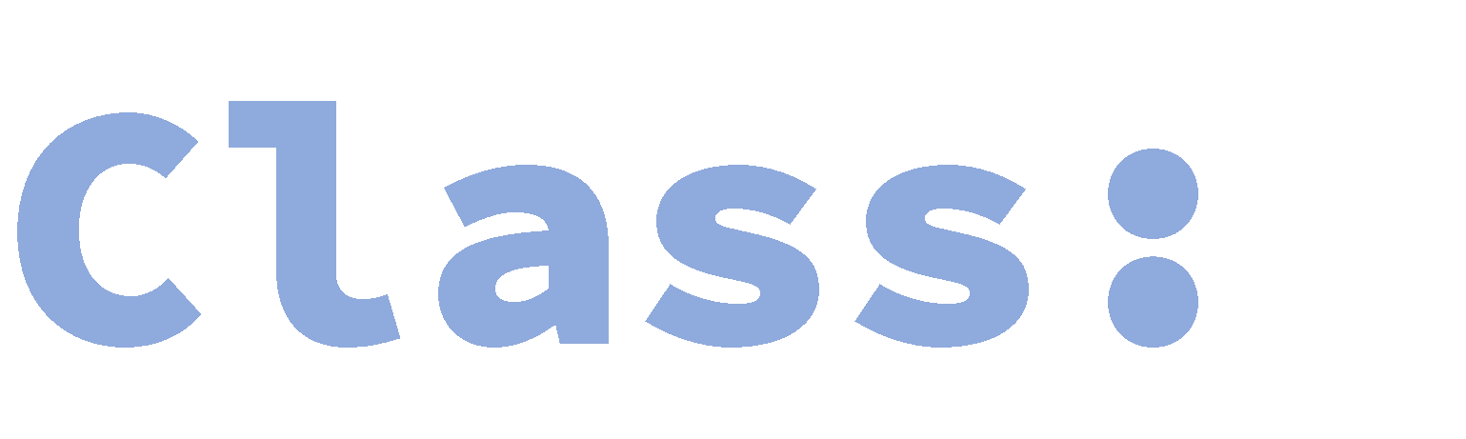
import scala.math.{sqrt,pow} //abs is not visible class Person(val name: String, var age: Int) {} var p = new Person("Peter", 21)
p.age += 1
class Point(private var x: Double, val y: Double) {
def distanceTo(o:Point) = sqrt(pow(x-o.x,2) + pow(y-o.y,2))
}
var p1 = new Point(3,4) //p1.y += 1, y is value not varibale var p2 = new Point(3,6)
println(p1.distanceTo(p2)) //2

Slide 39

Scala’s way for “statics”
not quite – see next slide
(in Scala, there is no static keyword)
“Companion object” for a class
• = object with same name as the class

Slide 40
// we declare singleton object "Person"
// this is a companion object of class Person object Person { def defaultName() = "nobody" } class Person(val name: String, var age: Int) {
def getName() : String = name
}
// surprise, Person is really an object val singleton = Person Person.defaultName()

Slide 41

Implicitly override toString, equals, hashCode
take object’s structure into account
Useful in pattern matching
case class Person(private val name: String, private val age: Int) {} val p1 = new Person("Hossein",21)
p1: Person = Person(Hossein,21)
val p2 = Person("Hossein",21) p1 == p2 //== is equivalent to equals

Slide 42

Traits are used to share interfaces and fields between classes. They are similar to Java 8’s interfaces.
trait Pet {
val name: String
def greet(): String = { return s"Hi, I'm ${name}" }
}
case class Dog(name:String) extends Pet val dog = Dog("Hachi")
dog.greet()
res0: String = Hi, I’m Hachi

Slide 43
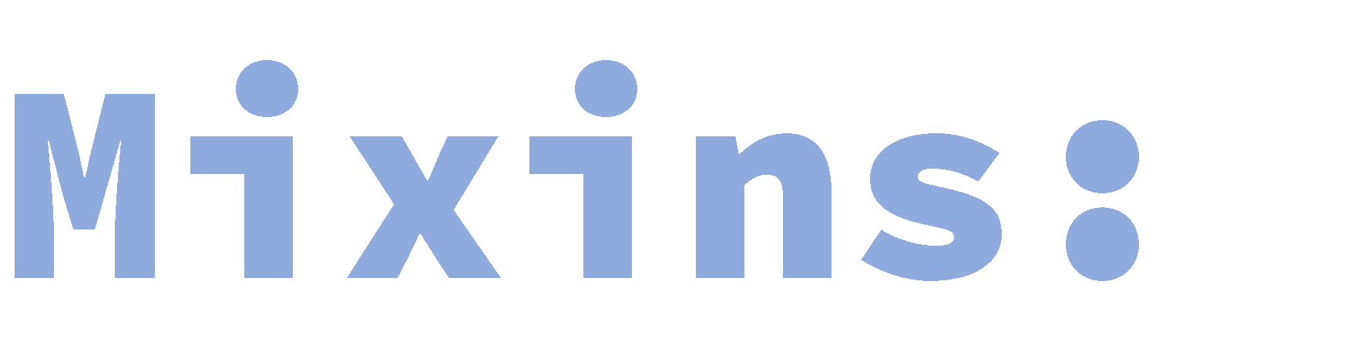
Mixins are a language concept that allows a programmer to inject some code into a class.
Typically, the mixin will export the desired functionality to a child class, without creating a rigid, single "is a" relationship.
It provides a mechanism for multiple inheritance by allowing multiple classes to use the common functionality, but without the complex semantics of multiple inheritance.
Mixins encourage code reuse and can be used to avoid the inheritance ambiguity that multiple inheritance can cause (the "diamond problem")

Slide 44
trait Language {
val name:String
override def toString = name
}
trait JVM { override def toString = super.toString+" runs on JVM" } trait Static { override def toString = super.toString+" is Static" } class Scala extends Language with JVM with Static {
val name = "Scala"
}
println(new Scala)
// Scala runs on JVM is Static

Slide 45


Slide 46
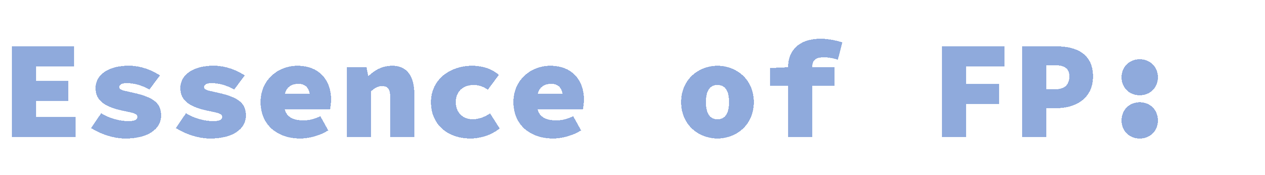
First-class functions
Functions as variables, method parameters, and return value
Pure functions
No side effect
Recursion
Immutable variables
Non-Strict evaluation
Delay evaluation until the last moment
Statements
Expression-Oriented
Pattern matching

Slide 47

def fibo(n:Int) : Int = if(n<2) n else fibo(n-1) + fibo(n-2)
fibo: fibo[](val n: Int) => Int
for( i <- 0 to 10) yield fibo(i)
res0: res0: scala.collection.immutable.IndexedSeq[Int]
= Vector(0, 1, 1, 2, 3, 5, 8, 13)

Slide 48
def func(x:Int,y:Int, z:(Int,Int)=>Int): Int = z.apply(x,y) func(2,3,(x,y)=> x*y)
val adder = (x:Int,y:Int)=> x+y func(2,3,adder) func(2,3,(x,y)=> (x*x-y*y).abs)

Slide 49

A Closure is a function, whose return value depends on the value of one or more variables declared outside this function.
var offset = 1
val plusOffset = (x:Int) => x + offset plusOffset(5) // 6
foo = 5
plusOffset(5) // 10

Slide 50
Tail Recursive function is a function calls itself as its final operation. A Tail Recursive Function can automatically optimized by compiler to avoid Stack Overflow problem.

Slide 51

import scala.annotation.tailrec
// 1 - basic recursive factorial method
def factorial(n: Int): Int = if (n == 0) 1 else n * factorial(n-1)
// 2 - tail-recursive factorial method def factorial2(n: Long): Long = {
@tailrec
def factorialAccumulator(acc: Long, n: Long): Long = {
if (n == 0) acc else factorialAccumulator(n*acc, n-1)
}
factorialAccumulator(1, n)
}

Slide 52

Note : In Java, all method invocations are call-by-value.
Scala gives you an additional mechanism for passing parameters to methods (and functions):
Call-by-name, which passes a code block to the callee. Each time the callee accesses the parameter, the code block is executed and the value is calculated.
Call-by-name allows you to pass parameters that might take a longtime to calculate but may not be used.

Slide 53
def delayed(t: => Int) = println("delayed method") def notDelayed(t: Int) = println("Indelayed method") def infinite() : Int = {
print("X") infinite()
}
delayed(infinite()) // delayed method notDelayed(infinite()) //XXXXXXXXXXXXXXXXXX…

Slide 54
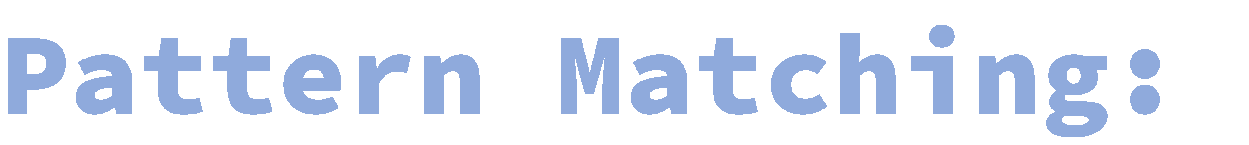
def what(any:Any) = any match { case i:Int => "It's an Int"
case s:String => "It's a String" case _ => "I don't know what it is"
}
what(123) //"It's an Int" what("hello") //"It's a String" what(false) //"I don't know what it is"

Slide 55
val books = List("Beginning Scala", "Beginning Groovy", "Beginning Java", "Scala in 24 hours")
for (book<-books) println(book) var scalabooks =
for{ book <-books if book.contains("Scala") } yield book
scalabooks: List[String] = List(Beginning Scala, Scala in 24 hours) for(book<-books if book.contains("Scala") ) println(book) books.foreach(println(_))

Slide 56

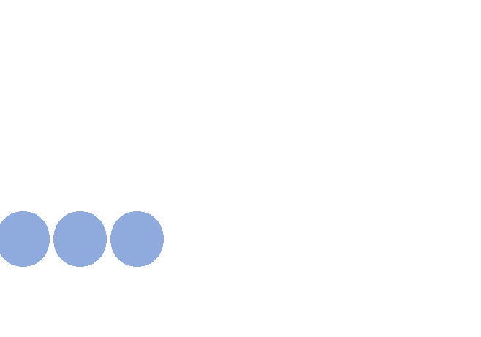

(1 to 20).filterNot(elem => elem % 2 == 0)
.filter(_ % 3 == 0)
.map(elem => elem * elem)
.foldLeft(1)(_ * _) //164025
import scala.io.Source // count characters occurrences val lines = Source.fromFile(“path").getLines() lines.flatMap(_.toCharArray)
.foldLeft(Map[Char, Int]() withDefaultValue 0) ((acc, c) => acc updated (c, acc(c)+1))

Slide 57

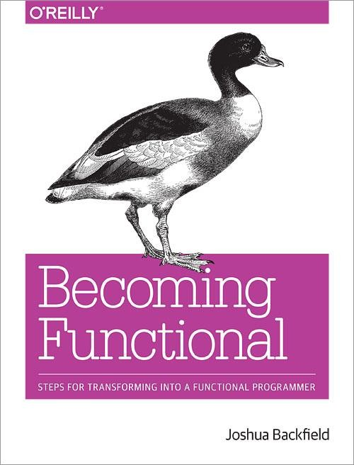
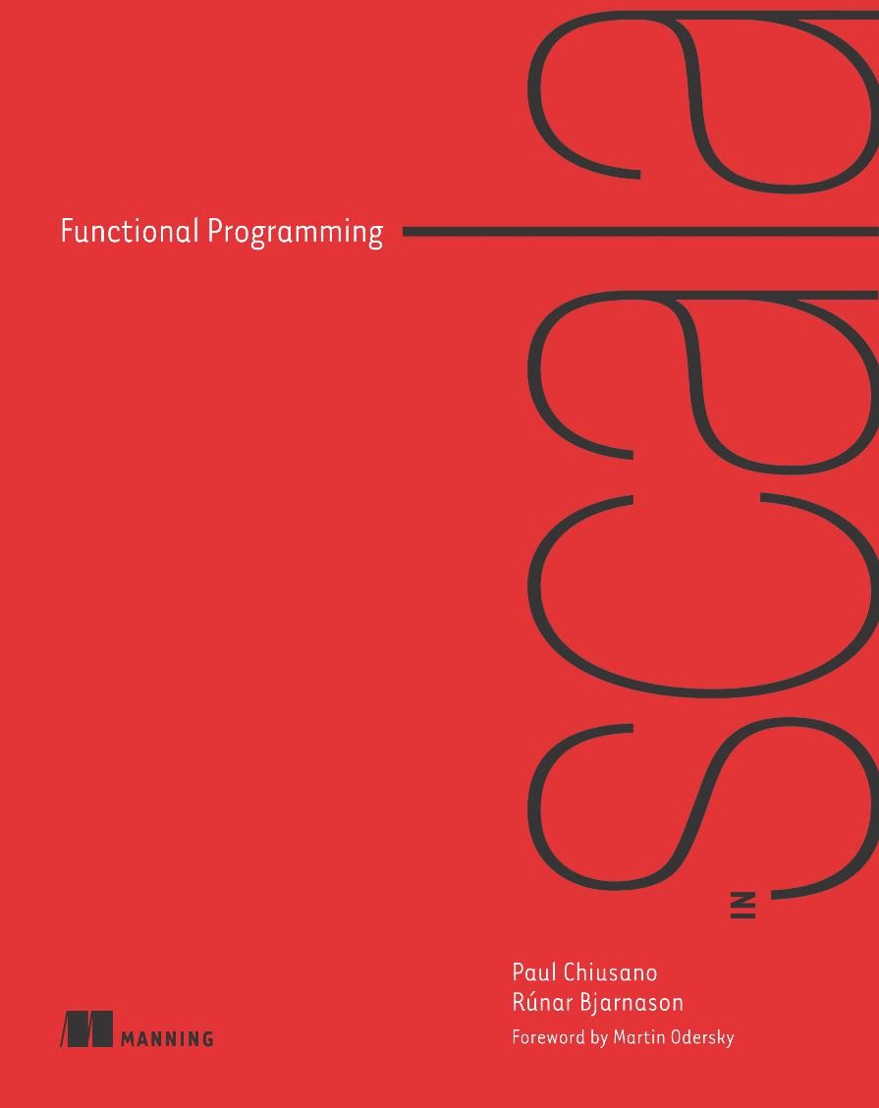

Slide 58



Slide 59
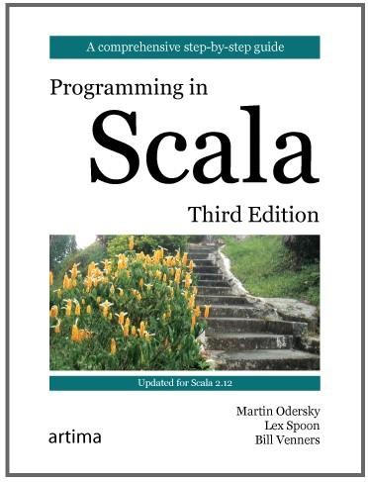
Functional Programming in Scala
Specialization on Coursera.
Explore Scala Ecosystem, especially Akka and
Play.
Think Functional; don’t look over books and tutorial with such a name like “Scala for X developers”
Learn Functional Reactive Programming in Scala.
Explore other advanced futures of Scala like Macros, DSL & Parser Combinator, Monad and Monoid, …

